Slide 1
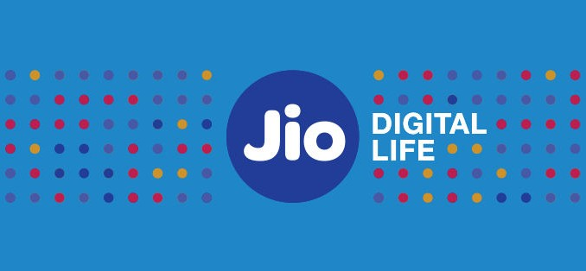
AI Chatbot for LMS Portal
Reliance Jio – Associate-Intern, Soft Developer (AI Chatbot Systems) | January 2026 – July 2026
Mentor : Mr. Jeetendra Pradhan and Mr. Pradeep Tiwari

Slide 2
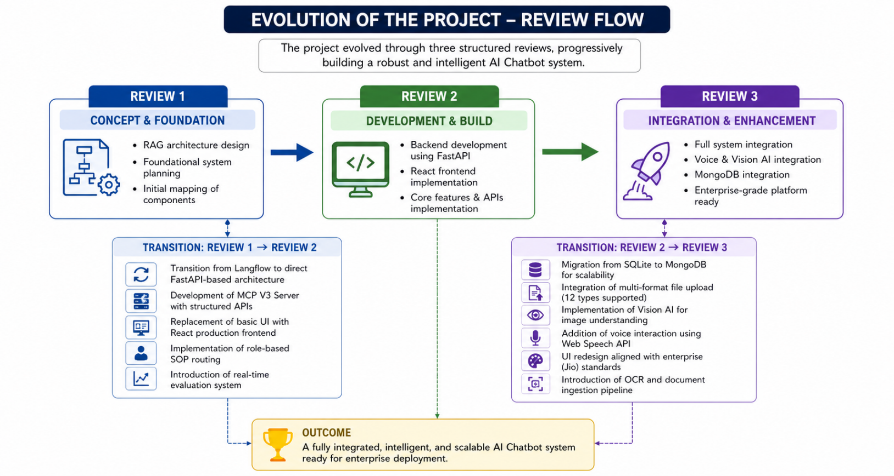
Project Recap & Evolution The project evolved through three structured phases, starting from a conceptual RAG-based design to a fully functional AI chatbot system integrated with voice and vision capabilities. Each review phase focused on enhancing system scalability, usability, and real-world applicability, ultimately transforming the solution into a production-ready enterprise-grade platform. Project Phases Review 1: RAG architecture design and foundational system planning Review 2: Backend development using FastAPI Review 3: Full system integration with Voice, Vision AI, and React frontend implementation and MongoDB Key Transition: Review 1 → Review 2 Transition from Langflow to direct FastAPI-based architecture Development of MCP V3 Server with structured APIs Replacement of basic UI with React production frontend Implementation of role-based SOP routing Introduction of real-time evaluation system Key Transition: Review 2 → Review 3 Migration from SQLite to MongoDB for scalability Integration of multi-format file upload (12 types supported) Implementation of Vision AI for image understanding Addition of voice interaction using Web Speech API UI redesign aligned with enterprise (Jio) standards Introduction of OCR and document ingestion pipeline

Slide 3
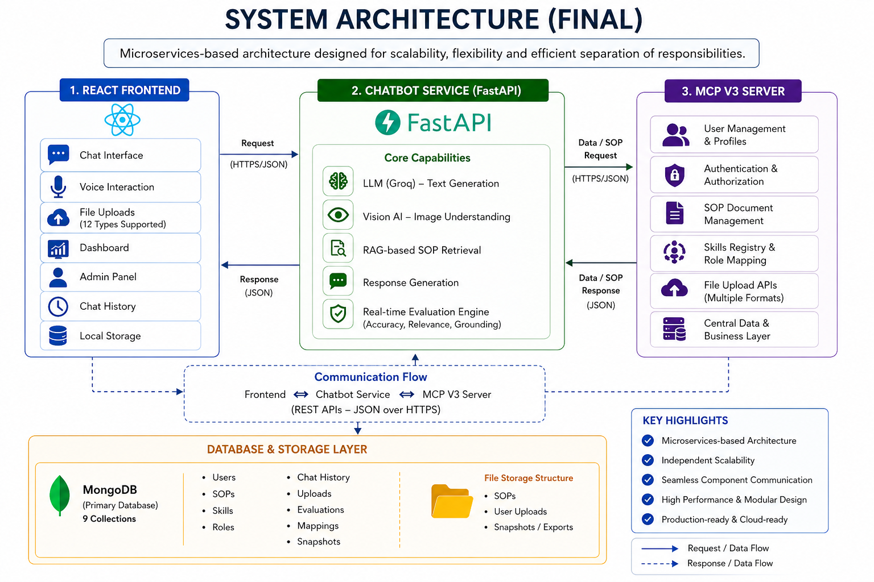
System Architecture (Final)
The system follows a microservices-based architecture designed to ensure scalability, flexibility, and efficient separation of responsibilities across components.
It consists of three primary layers: a React-based frontend for user interaction, a Chatbot service responsible for handling AI-driven processing and response generation, and an MCP V3 server that manages data, user profiles, and system-level operations. The frontend enables features such as chat, voice interaction, file uploads, and dashboard access, providing a seamless and responsive user experience.
The Chatbot service, built using FastAPI, integrates with advanced language and vision models to process both text and image inputs while leveraging RAG-based logic to deliver contextually accurate responses.
The MCP V3 server acts as the backbone of the system, handling SOP storage, user-role mapping, and overall data management through MongoDB, which is structured into multiple collections for optimized performance.
This modular architecture allows independent scaling of services, easier maintenance, and efficient communication between components, making the system robust and production-ready.

Slide 4
Objectives: Technical & Business Outcomes
The primary objective of this project was to design and develop an intelligent AI-powered chatbot system for an LMS portal that can provide accurate, context-aware responses using SOP-based knowledge. The system aimed to enhance user interaction by supporting multiple input modes, including text, voice, and images, while ensuring scalability and real-time performance in an enterprise environment.
Another key objective was to implement a robust backend architecture using microservices, enabling efficient data handling, role-based access, and seamless integration with modern AI models. Additionally, the project focused on improving user experience through a responsive frontend interface and incorporating evaluation mechanisms to continuously monitor and enhance response quality.
As a result, the project successfully delivered a fully functional, production-ready chatbot system capable of handling real-time queries with high accuracy and relevance. The integration of RAG-based retrieval ensured that responses were grounded in SOP data, while the addition of voice and vision capabilities significantly improved usability and interaction flexibility.
The transition to a MongoDB-based backend enabled better scalability and performance, and the implementation of an evaluation dashboard provided measurable insights into system effectiveness. Overall, the system achieved its intended goals of enhancing knowledge accessibility, improving user engagement, and demonstrating the practical application of AI in enterprise learning environments.

Slide 5
Working of the System
The working of the system begins when a user interacts with the chatbot through the React-based frontend, either by typing a query, using voice input, or uploading a file such as an image or document. The input is first captured and preprocessed on the frontend and then sent to the Chatbot Service via API calls. If the input is voice, it is converted into text using the Web Speech API before being processed further. In case of file uploads, the system extracts relevant content using appropriate tools such as PDF parsers or vision models for images.
Once the input reaches the Chatbot Service, it is processed using a Retrieval-Augmented Generation (RAG) approach, where relevant SOP data is fetched from the MCP V3 Server based on the user’s role and query context. This retrieved information is then combined with the user query and passed to the LLM, which generates a contextually accurate response. If the query includes an image, the Vision model analyzes it and contributes to the response generation.
The generated response is then evaluated internally for accuracy, relevance, and grounding before being sent back to the frontend. Finally, the user receives the response in real time, along with optional suggestions for follow-up queries. This entire flow ensures that the system delivers fast, accurate, and context-aware answers while supporting multiple input formats and maintaining a smooth user experience.

Slide 6

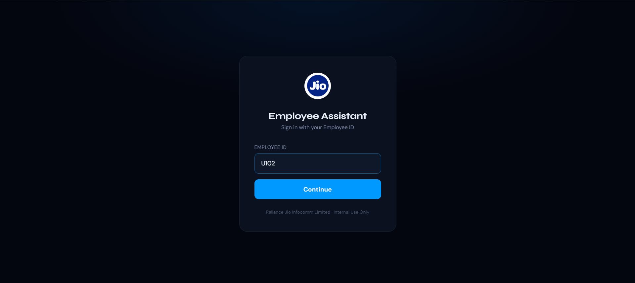

Slide 7
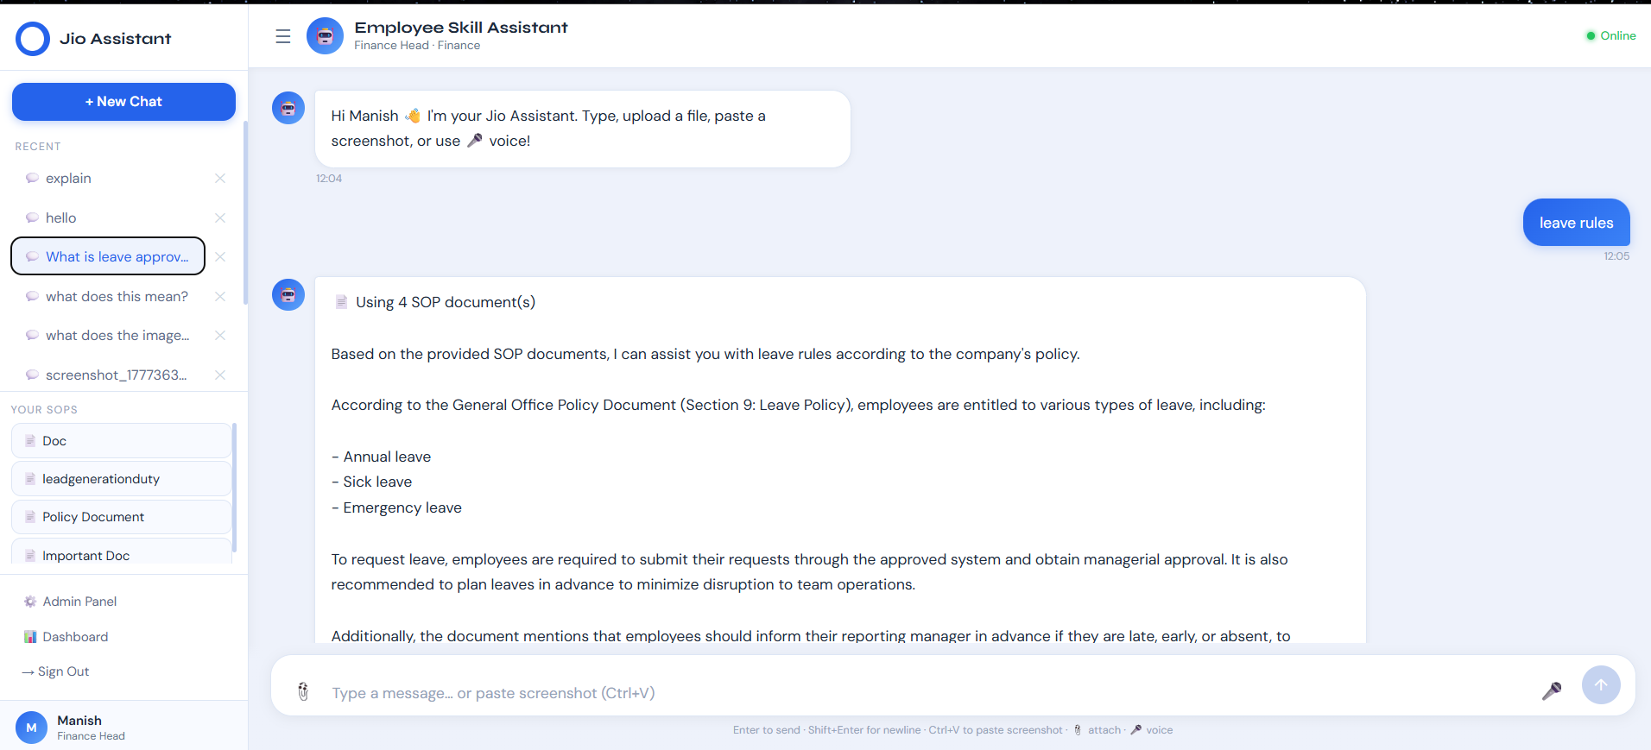

Slide 8
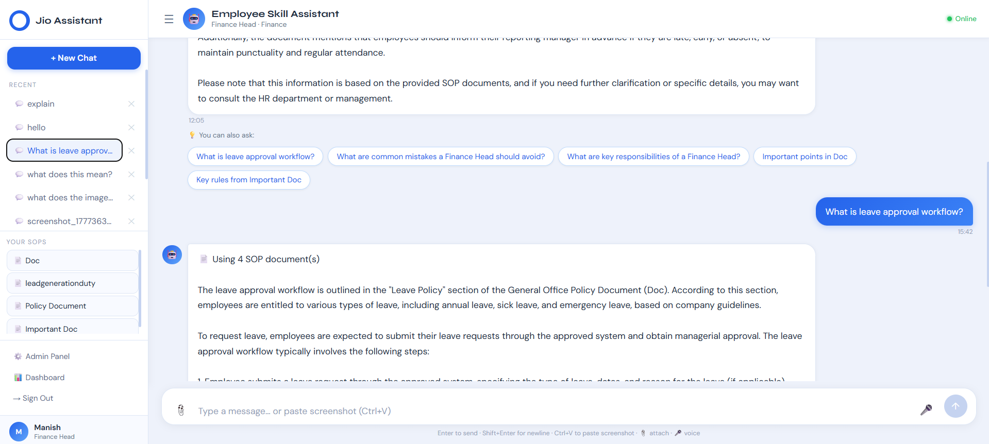

Slide 9
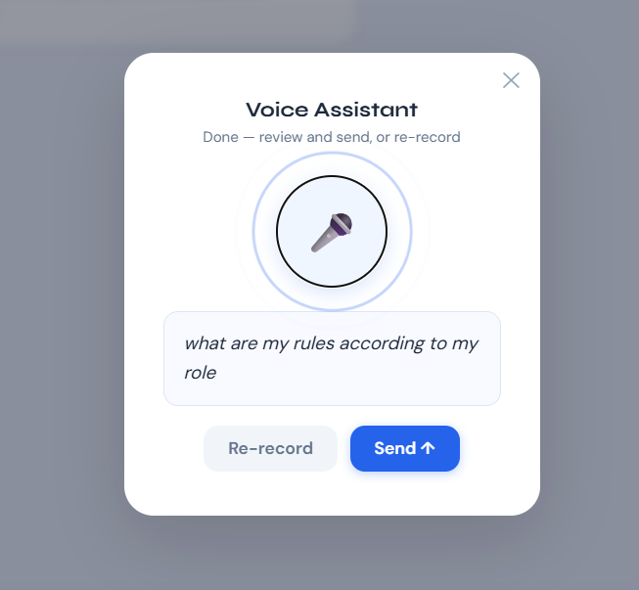
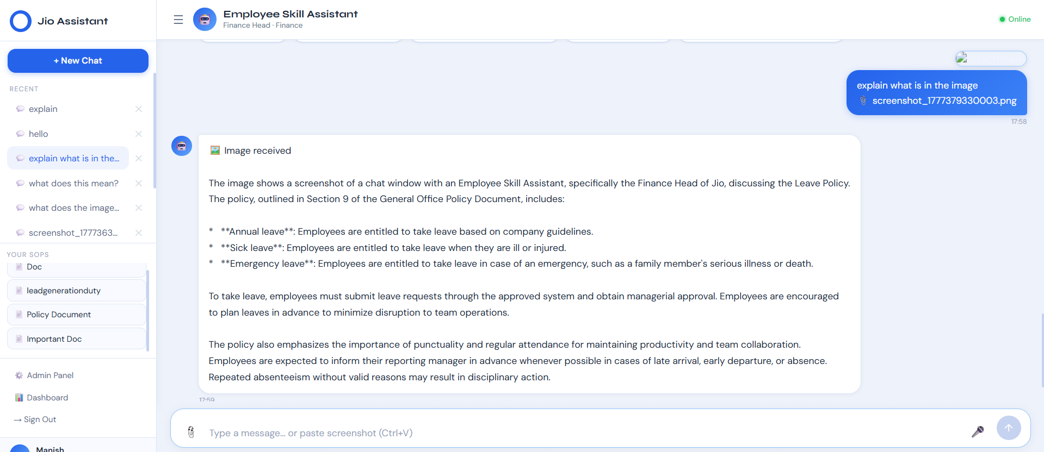

Slide 10
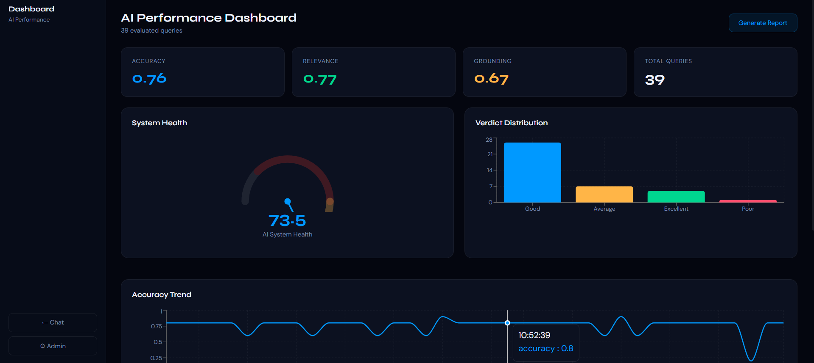
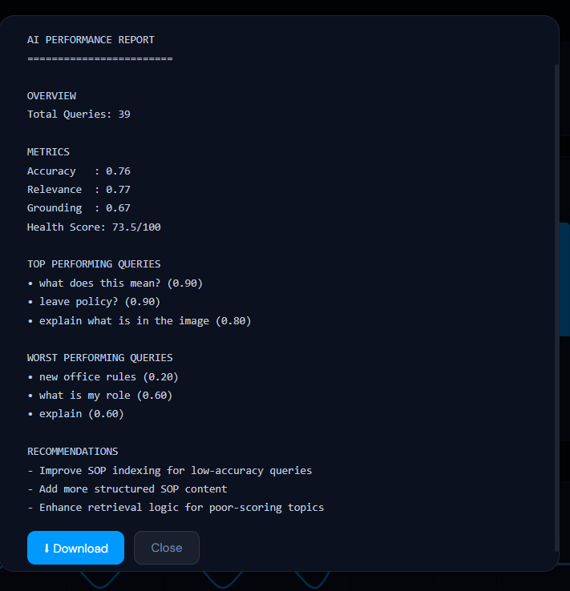
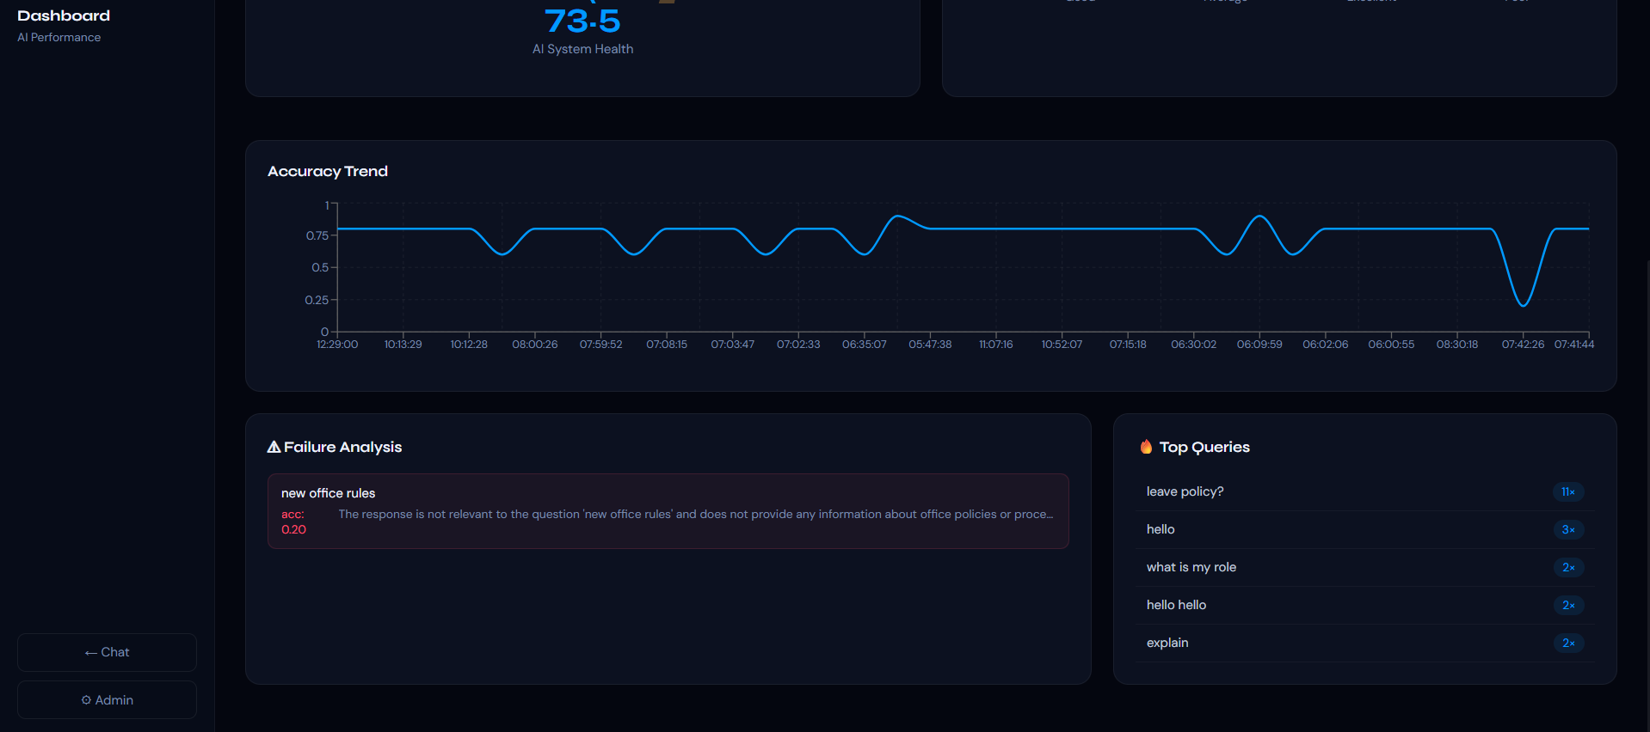

Slide 11
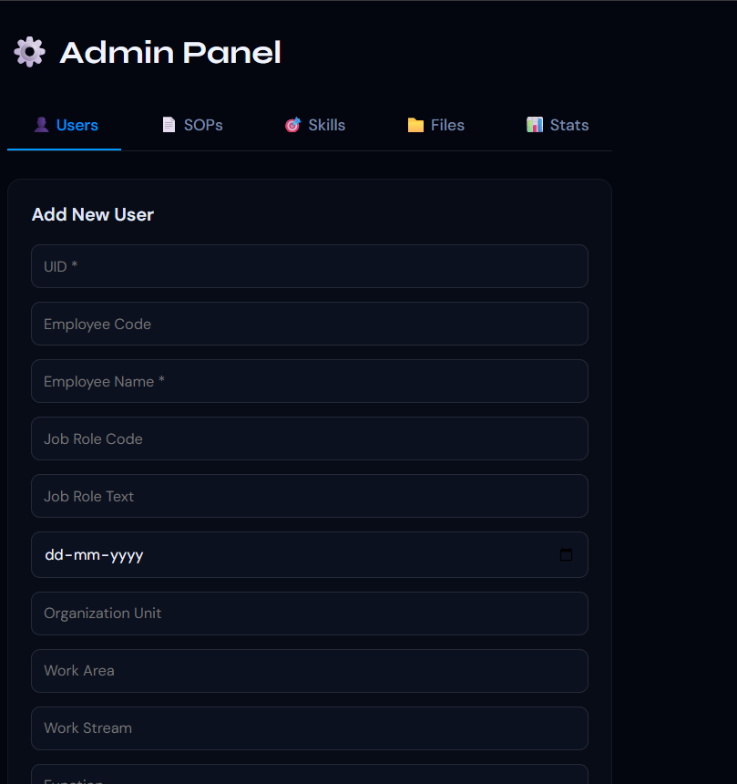
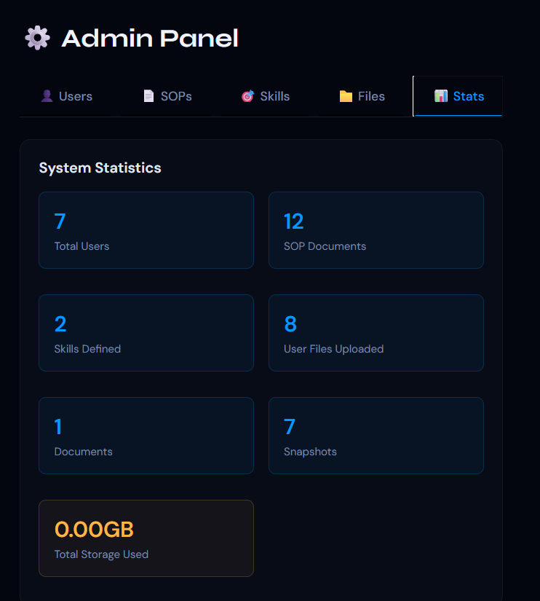
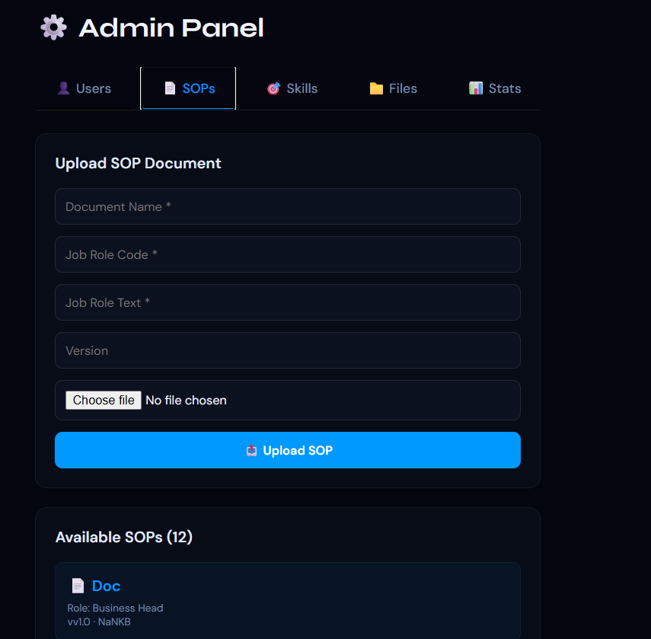
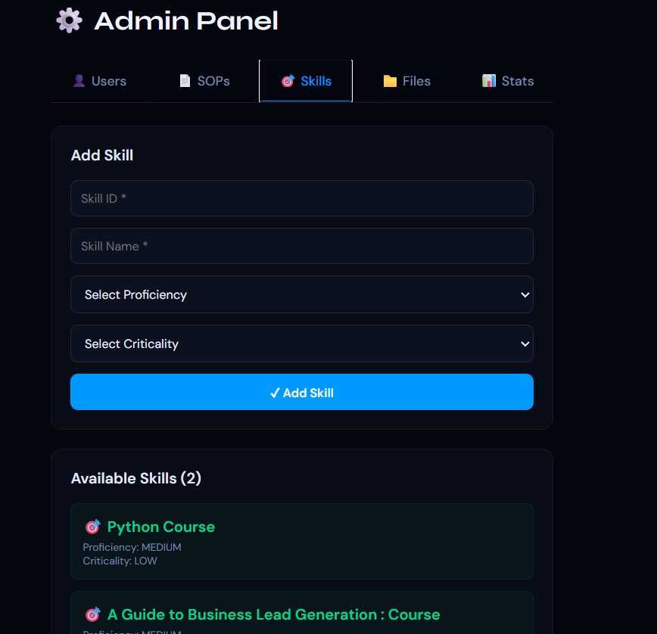

Slide 12
TECH STACK
Frontend: React.js (Hooks, Component-based architecture, Responsive UI)
Backend: FastAPI (Python, high-performance REST APIs, microservices architecture)
Database: MongoDB (NoSQL, 9 collections, scalable and flexible storage)
LLM Engine: Groq API – llama-3.1-8b-instant (fast and efficient text generation)
Vision Model: Groq Vision – llama-4-scout (image understanding and processing)
Voice Processing: Web Speech API (browser-based speech-to-text, no external setup)
File Processing:
PDF: pdfplumber, PyPDF2
DOCX: python-docx
Excel: openpyxl
Image Handling: Base64 encoding + Vision API integration
Architecture Style: Microservices (Frontend + Chatbot Service + MCP Server)
API Communication: REST APIs (JSON-based request/response handling)
Deployment Tools: Uvicorn (backend server), npm serve (frontend hosting)
Storage: Local file storage (SOPs, uploads, snapshots)

Slide 13
Conclusion The AI Chatbot System for the LMS portal was successfully developed as a scalable and production-ready solution that integrates advanced AI capabilities with a robust microservices architecture. The project achieved its goal of delivering accurate and context-aware responses using a RAG-based approach, ensuring that all outputs are grounded in relevant SOP data. The system was enhanced with multi-modal interaction features, including voice and image processing, which significantly improved user experience and accessibility. With the implementation of MongoDB and multiple independent services, the platform demonstrates strong performance, flexibility, and readiness for real-world enterprise deployment. Overall, the project highlights the practical application of AI in improving knowledge management and user engagement within an organizational ecosystem. Future Scope The future scope of this system focuses on expanding its capabilities to make it more intelligent, accessible, and enterprise-integrated. Enhancements can include multi-language support to cater to a diverse user base, integration of vector databases like ChromaDB for improved semantic search and retrieval accuracy, and implementation of Single Sign-On (SSO) for seamless enterprise authentication. The system can also be extended into a mobile application using React Native to increase accessibility across devices. Additional features such as text-to-speech for voice responses, continuous learning through feedback-based model improvement, and deeper integration with HR systems can further enhance its effectiveness. These improvements will help evolve the chatbot into a more adaptive, intelligent, and widely usable enterprise solution.

Slide 14
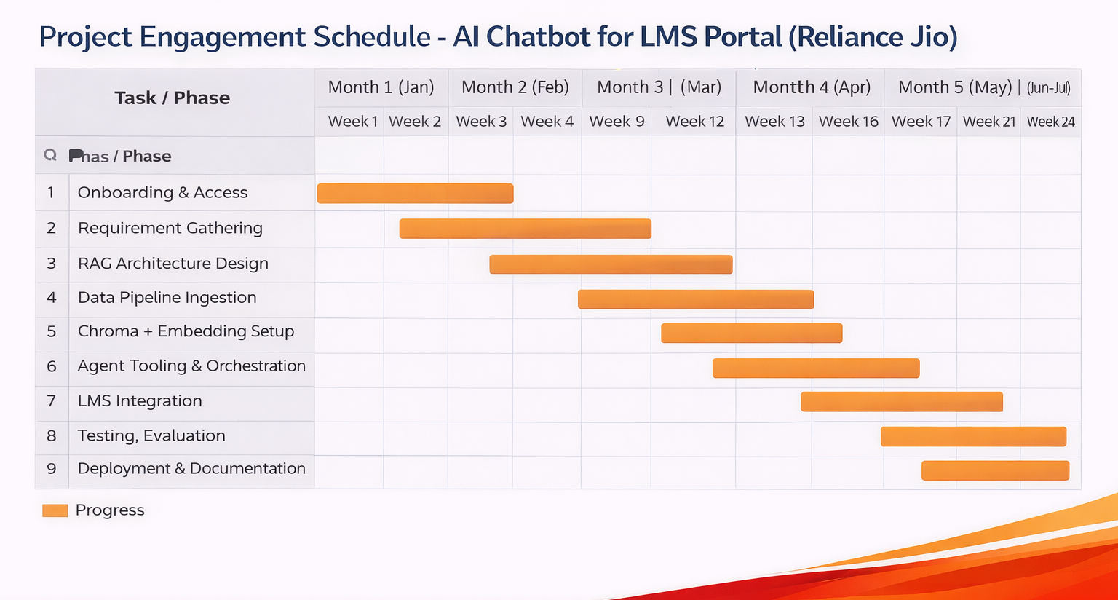
Gantt Chart
Initial Phase (Weeks 3–15 | AI Chatbot Focus)
Design and finalize RAG-based chatbot architecture and data pipelines.
Complete document ingestion, embedding, and Chroma vector database setup.
Implement agent tooling, integrate chatbot with LMS, and perform testing & deployment.
Long Term (Weeks 16–30 | Other Projects & Enhancements)
Contribute to additional AI and software development projects within the organization.
Work on enhancement, optimization, and maintenance of deployed chatbot systems.
Gain exposure to broader enterprise applications, APIs, and system integrations.

